Slide 1
Abstract
Diabetes-induced renal failure remains a prevalent health issue in the United States, necessitating innovative quality improvement (QI) interventions. This quality improvement presentation poster underscores the vital role of quality improvement methods in healthcare to enhance patient care, safety, and overall service quality. The Plan-Do-Study-Act (PDSA) cycle is explored, though it is not without limitations, particularly in addressing complex or systemic healthcare challenges. Supported by evidence, the proposed methods for managing diabetes-induced renal failure hold potential, but knowledge gaps persist. To overcome potential challenges and ensure a successful transition, comprehensive training, resource allocation, and a patient-centric approach are recommended. Moreover, interprofessional teamwork is highlighted as a critical factor in improving project efficiency. In conclusion, these quality improvement methods promise multifaceted benefits, including reduced errors, enhanced healthcare awareness, and a more supportive healthcare environment.

Slide 2
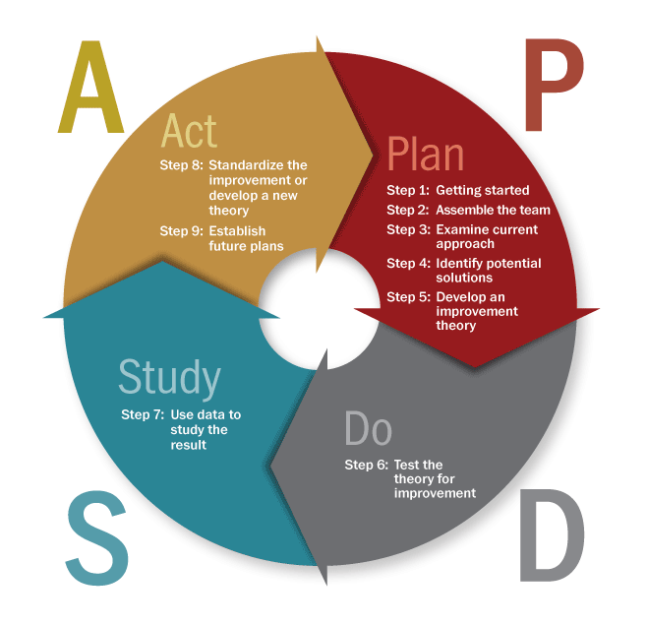
Quality Improvement Presentation Poster Name Capella University Biopsychosocial Concepts for Advanced Nursing Practice I Quality Improvement Presentation Poster
Quality Improvement Methods
Quality improvement methods play a pivotal role in the healthcare industry, aimed at enhancing patient care, safety, and the overall quality of healthcare delivery. These methods are critical in addressing the evolving complexities of healthcare, including the increasing prevalence of chronic conditions, biopsychosocial considerations, and the need for equitable care (Mandel & Cady, 2022). Quality improvement methods encompass a wide array of strategies, tools, and approaches designed to identify, measure, and address areas of improvement in patient outcomes, processes, and organizational performance.
In the contemporary healthcare landscape, the importance of quality improvement methods cannot be overstated. These methods empower healthcare professionals to engage in systematic problem-solving, data-driven decision-making, and continuous assessment of their practices. They provide a structured framework to bridge the gap between clinical research, evidence-based practices, and the actual care delivered at the patient's bedside. Quality improvement methods are instrumental in not only elevating the quality and safety of healthcare but also in promoting cost-effectiveness and efficiency, thereby ensuring that healthcare resources are optimally utilized for the benefit of patients (Mandel & Cady, 2022). This introduction sets the stage for an exploration of the significance and applications of quality improvement methods in addressing the challenges and complexities within the healthcare system.
Solutions to Meet Challenges
Firstly, effective change management strategies, such as comprehensive training and communication plans, can help healthcare professionals and patients embrace the proposed improvements. These strategies should emphasize the benefits of the changes and provide support for individuals transitioning to new practices. Secondly, efficient resource allocation and planning are essential. This involves identifying the required resources, including financial investments, and ensuring they are readily available. Collaborative scheduling and coordination among healthcare professionals can be facilitated through interprofessional teamwork, enabling a more seamless and efficient execution of the quality improvement project (Cortes, 2019).
Interprofessional Team Benefits
Interprofessional teamwork will significantly enhance the effectiveness and efficiency of the quality improvement project by leveraging the diverse expertise of various healthcare professionals, including physicians, nurses, and mental health specialists. The assumption underlying this analysis is that a multidisciplinary approach is essential to address the complex biopsychosocial considerations of renal failure due to diabetes. Collaboration among these professionals is expected to lead to a holistic and patient-centered approach to care, ensuring that the medical, psychological, and social aspects are all considered (Tan et al., 2020). Moreover, the assumption is that effective communication and coordination among team members will minimize the potential gaps in patient care and optimize the utilization of resources and interventions
Limitations of the PDCA Cycle
The Plan-Do-Study-Act (PDSA) cycle is a widely used quality improvement method in healthcare, but it does come with some limitations. One key limitation is that it might not be suitable for addressing complex or systemic issues within healthcare systems. The PDSA cycle is more effective when dealing with small-scale, localized problems and improvements. When attempting to tackle larger, multifaceted issues that involve multiple departments, resources, or stakeholders, the simplicity of the PDSA cycle may fall short (Knudsen et al., 2019). Complex healthcare problems often require more comprehensive, long-term planning, and the involvement of various professionals and departments, making it challenging to fit within the confines of the PDSA cycle.
Another limitation of the PDSA cycle is the potential for it to become a routine, check-the-box activity without genuinely driving meaningful improvement. In some cases, healthcare organizations may adopt the PDSA cycle as a standard practice, but without the genuine commitment to making changes based on the results of each cycle. This can lead to a sense of complacency and minimal real impact on patient care. It is vital to emphasize that the effectiveness of the PDSA cycle relies on the genuine engagement of healthcare professionals and stakeholders, and if it becomes a superficial exercise, its utility diminishes (Knudsen et al., 2019).
Overall Project Benefits
The overall project benefits are multifaceted and impactful. The quality improvement methods, grounded in evidence-based practices and supported by interprofessional teamwork, promote enhanced patient care and health outcomes. This approach not only leads to reduced medical errors and failures but also fosters a collaborative, patient-centric environment, resulting in improved healthcare awareness among patients. By equalizing training and education for healthcare teams and streamlining processes, the project contributes to greater efficiency and reduced barriers to effective treatment. In essence, the project's holistic benefits span improved patient care, more informed and skilled healthcare professionals, and a safer, more supportive healthcare environment.
Change Strategy Foundation
References
Evidence Supporting QI Methods
The project is rooted in successful change strategies by utilizing the Plan-Do-Study-Act (PDSA) cycle, a well-established method in healthcare quality improvement. This strategy involves systematic planning, implementation, assessment, and adjustment based on the evidence. The PDSA cycle allows for a structured and iterative approach, enabling healthcare professionals to adapt and refine their practices continuously. Potential challenges may include resistance to change from both healthcare providers and patients, who might be accustomed to traditional approaches (Eboreime et al., 2020). To address this, the project will implement a comprehensive training program to ensure that all stakeholders, including healthcare professionals and patients, are well-informed and engaged in the process. Furthermore, ongoing evaluation and feedback mechanisms will be established to identify any issues and adapt strategies accordingly, fostering a culture of continuous improvement.
Beaubien-Souligny, W., Leclerc, S., Verdin, N., Rizwana Ramzanali, & Fox, D. E. (2022). Bridging gaps in diabetic nephropathy care: A narrative review guided by the lived experiences of patient partners. Canadian Journal of Kidney Health and Disease, 9, 205435812211279-205435812211279. https://doi.org/10.1177/20543581221127940
Cortes, T. (2019). Building interprofessional teams through partnerships to address quality. Nursing Science Quarterly, 32(4), 288–290. https://doi.org/10.1177/0894318419864343
Eboreime, E. A., Olawepo, J. O., Banke-Thomas, A., & Ramaswamy, R. (2020). Evaluating the design and implementation fidelity of an adapted Plan-Do-Study-Act approach to improve health system performance in a Nigerian state. Evaluation and Program Planning, 84, 101876. https://doi.org/10.1016/j.evalprogplan.2020.101876
Kearsley-Ho, E. L., Yang, H. Y., Karunananthan, S., Laur, C., Grimshaw, J. M., & Ivers, N. M. (2019). When do trials of diabetes quality improvement strategies lead to sustained change in patient care? BMJ Quality & Safety, 29(9), 774–776. https://doi.org/10.1136/bmjqs-2019-009658
Knudsen, S. V., Laursen, H. V. B., Johnsen, S. P., Bartels, P. D., Ehlers, L. H., & Mainz, J. (2019). Can quality improvement improve the quality of care? A systematic review of reported effects and methodological rigor in plan-do-study-act projects. BMC Health Services Research, 19(1), 1–10. https://doi.org/10.1186/s12913-019-4482-6
Lucilene Renó Ferreira, Vanessa Ribeiro Neves, & Anderson. (2022). Challenges in the evaluation of primary care from a quality improvement program. Escola Anna Nery, 26. https://doi.org/10.1590/2177-9465-ean-2021-0287en
Mak, V., Brand, G., & Morphet, J. (2022). Partnering with healthcare organizations to teach pre‐registration health professions students about quality improvement: A systematic review. Journal of Clinical Nursing. https://doi.org/10.1111/jocn.16426
Mandel, K. E., & Cady, S. H. (2022). Quality improvement as a primary approach to change in healthcare: A precarious, self-limiting choice? BMJ Quality & Safety, bmjqs-2021-014447. https://doi.org/10.1136/bmjqs-2021-014447
Tan, H. Q. M., Chin, Y. H., Ng, C. H., Liow, Y., Devi, M. K., Khoo, C. M., & Goh, L. H. (2020). Multidisciplinary team approach to diabetes. An outlook on providers’ and patients’ perspectives. Primary Care Diabetes, 14(5), 545–551. https://doi.org/10.1016/j.pcd.2020.05.012
Specific evidence supporting the quality improvement methods proposed for managing diabetes-induced renal failure can be found in various research studies. Studies provide evidence of the effectiveness of the Plan-Do-Study-Act (PDSA) cycle in healthcare settings, particularly for continuous quality improvement (Kearsley-Ho et al., 2019). They have shown that this method promotes evidence-based practices and real-time adjustments, leading to improved patient outcomes and reduced errors. Additionally, another study highlights the positive impact of quality improvement methods on patient education, which aligns with the proposed patient education program. Findings suggest that such programs can enhance patients' awareness of their condition, leading to better self-management and, subsequently, improved health outcomes (Mak et al., 2022).
Potential Challenges
Knowledge Gaps and Unknowns
Implementing quality improvement methods, particularly those focusing on biopsychosocial considerations, can be accompanied by several potential challenges. One significant challenge is the resistance to change among healthcare professionals and patients. Introducing new practices or altering existing ones can be met with apprehension and reluctance, especially if individuals are accustomed to traditional approaches. Overcoming this resistance necessitates effective change management strategies and clear communication to emphasize the benefits of the proposed improvements (Lucilene Renó Ferreira et al., 2022).
Another challenge lies in the allocation of resources, both in terms of time and finances. Implementing quality improvement methods requires dedicated time for training, planning, and execution. It may also involve investing in additional resources or technology. Finding the necessary resources and aligning them with the quality improvement project can be a logistical challenge. Moreover, the involvement of various healthcare professionals, each with their schedules and priorities, can pose coordination and scheduling challenges (Lucilene Renó Ferreira et al., 2022).
Several knowledge gaps and unknowns exist in the context of diabetes-induced renal failure management. Firstly, while there is evidence supporting the efficacy of quality improvement methods in general, there is a need for more specific research on the outcomes of applying these methods to the biopsychosocial aspects of managing diabetes-induced renal failure. Understanding how the proposed methods directly influence psychosocial aspects and patient adherence is an area requiring further exploration (Beaubien-Souligny et al., 2022). Moreover, little research has investigated the use of telehealth for patient education in this context. Therefore, there are unknowns concerning the effectiveness of this approach in enhancing patient understanding and motivation. Additionally, patient support groups' role and impact need further investigation, along with the identification of the most appropriate online platforms and strategies for fostering a sense of community among patients. Finally, questions persist about the specific content and structure of training programs for healthcare professionals in the PDSA cycle and interdisciplinary teamwork, and research is required to determine which training approaches are most effective (Beaubien-Souligny et al., 2022). Addressing these knowledge gaps and uncertainties is essential to ensure the proposed quality improvement methods are evidence-based and yield the desired outcomes for diabetes-induced renal failure management.

